Slide 1
Effects of Fisheries-induced Life History Shifts on Ecosystem Stability
Stephanie Bland
Supervisors: Anna Kuparinen and Jeffrey Hutchings
Notes:
I’m Steph, and my project is on the effects of fisheries-induced life history shifts on ecosystem stability. My supervisors are Anna and Jeff.

Slide 2
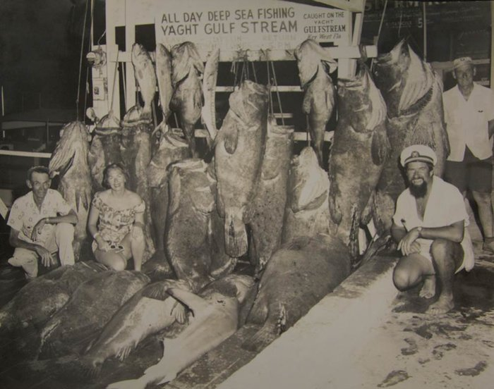
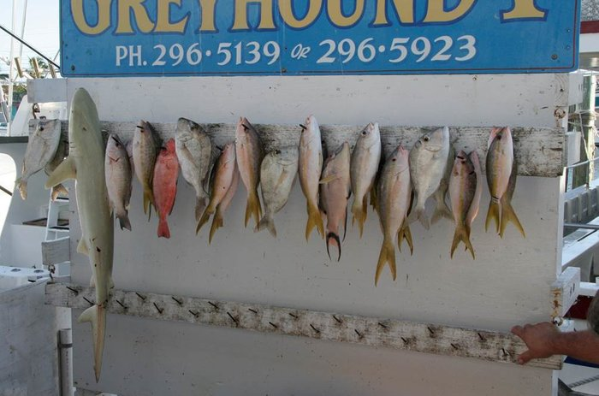

Fish size has been decreasing
Introduction
Fish size has decreased substantially in 50 years
1957
2007
McClenachan 2009
Notes:
Fishing has had a substantial effect on fish body size. For instance, these pictures are of trophy fish from sport fishing in the Florida Keys. This particular area has been posting their trophy fish on the same board every year for half a century, so we can record historical fish size. The one on the left was taken in 1957 and you can see that some of those fish are bigger than the fishermen. Fifty years later, in 2007, the trophy fish have an average length of 34 cm, or just over a foot.

Slide 3
Life History Shifts
Introduction
Fishing selects for smaller fish
Decreased body size
Shorter life spans
Earlier age of reproduction
Notes:
So this harvest selection for smaller fish has some evolutionary consequences on their life histories. Mainly, they have smaller body sizes at each life stage, shorter life spans, and earlier ages of reproduction.

Slide 4
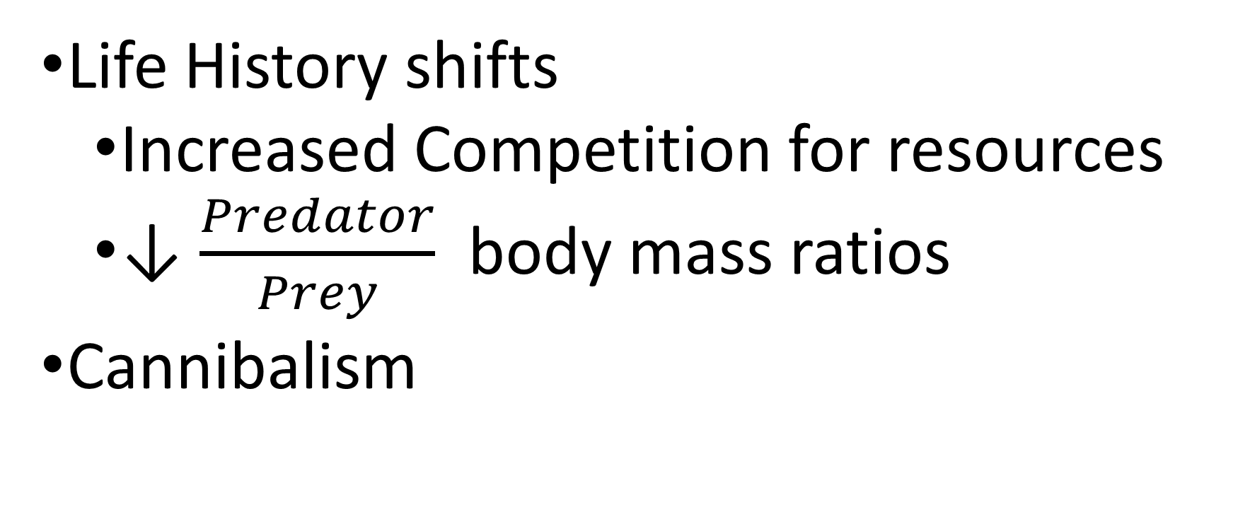
Ecosystem Stability
Introduction
Life History shifts
Increased Competition for resources
↓ $\frac{Predator}{Prey}$ body mass ratios
Cannibalism
Notes:
So we want to look at how ecosystem stability is affected by life history shifts and cannibalism
Life history shifts can affect ecosystem stability in two ways: through an increased competition for resources or by a decrease in predator-prey body mass ratios.

Slide 5
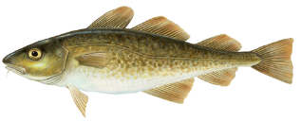
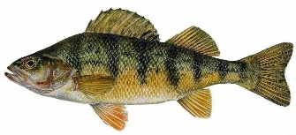
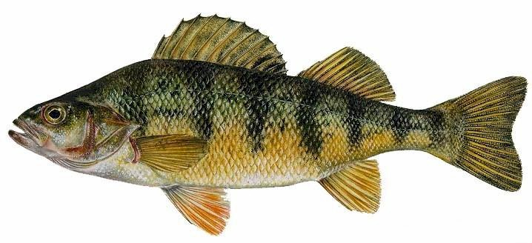
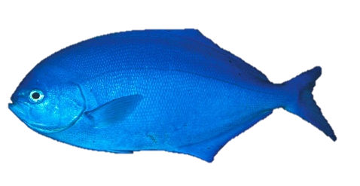
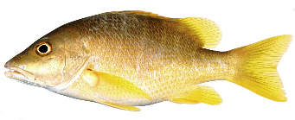
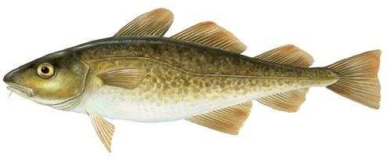
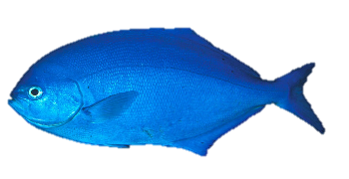
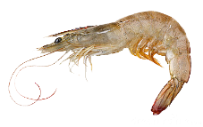



Increased competition between species
Introduction
Trawling limits fish size, so maximum fish size is truncated
But fish are limited to prey smaller than their gape size
Increased interspecific competition
Recovery from exploitation is slower
Notes:
Trawling puts an upper limit on body size, since it catches all fish above a certain size.
Since fish are limited by their gape size, their potential prey species are limited to organisms smaller than them.
However, the truncation of fish body size homogenizes fish size, so species are more likely to be the same size. This means that they are more likely to be competing for the same resources, and increases the competition between species.
Hence recovery from overfishing is slower.

Slide 6
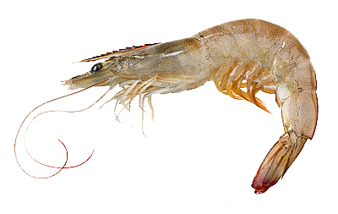
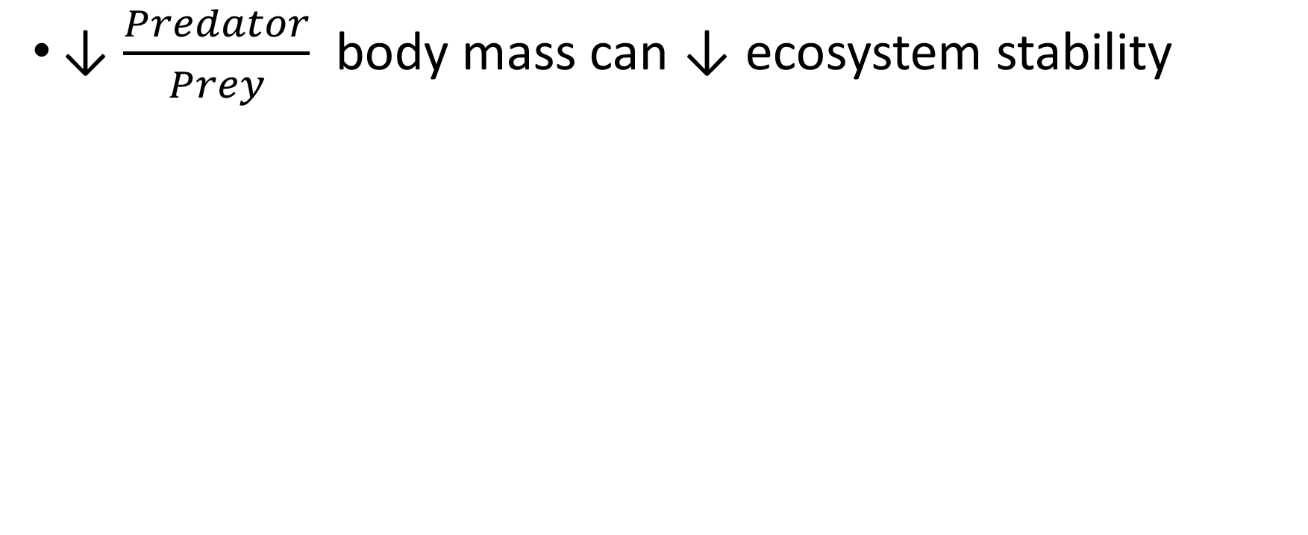
Predator-Prey Body Mass Ratio
Introduction
↓ $\frac{Predator}{Prey}$ body mass can ↓ ecosystem stability
Stable
Unstable
Notes:
Predator-prey body mass ratios also have an impact on ecosystem stability
A decrease in predator prey body mass ratios, for instance when predators start preying on prey closer to their own size, can destabilize ecosystems.

Slide 7
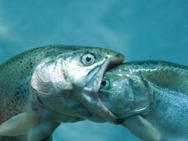
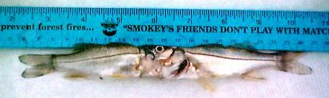
Cannibalism
Introduction
Cannibalism removes as much as 1/3 of juveniles in Cod
Affects around 1/10 of fish species
Effect on stability?
Notes:
In some species, such as Atlantic cod, cannibalism removes as much as 1/3 of juveniles. It’s also prevalent among fish species, it affects around 10% of fish species.
The role of cannibalism on stability of exploited aquatic ecosystems is still unclear.

Slide 8
Objective: What Influences Stability?
Objective
Fisheries induced life history shifts
Convergence of body size increase recovery through an increase in competition?
Decrease in predator-prey body mass ratios?
Cannibalism
Notes:
So my objectives are to examine what factors influence ecosystem stability. The main factor I will look at are fisheries induced life history shifts. This may affect stability in two ways: through a convergence in ecological niches, or through a decrease in predator-prey body mass ratios.
Since I am already including life histories, it is trivial to incorporate cannibalism into the model. My secondary objective will be to look at the impact of cannibalism on stability.

Slide 9

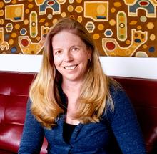
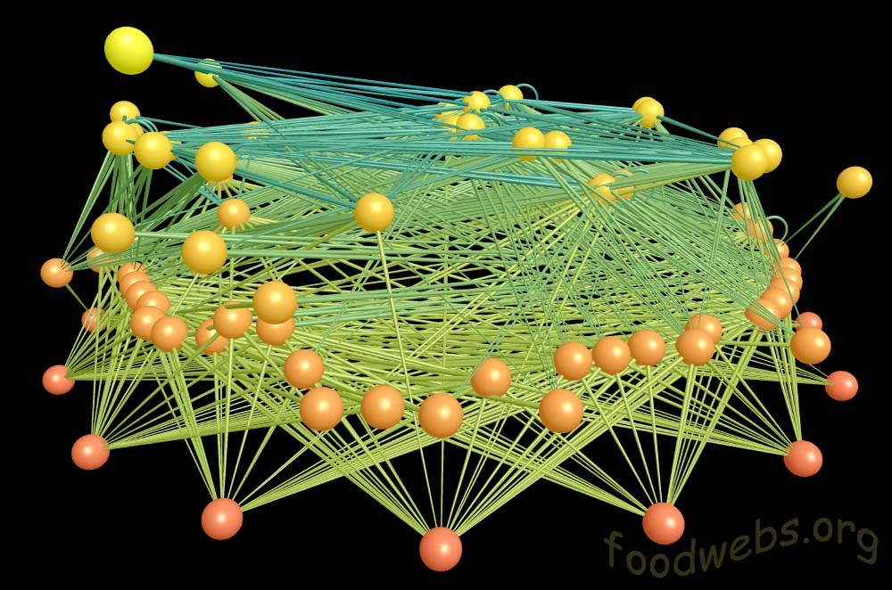
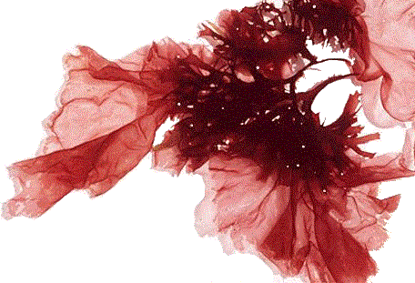
The Model
Background
Allometric Trophic Network
Scales metabolic rates and interactions by body size
Designed by Martinez lab
Each node is a species
Links between nodes are predator-prey interactions
Color is trophic level
Image produced with FoodWeb3D, written by R.J. Williams and provided by the Pacific Ecoinformatics and Computational Ecology Lab (www.foodwebs.org, Yoon et al. 2004).
Notes:
We will be modifying an allometric trophic network model designed by Martinez lab. Jennifer Dunne wrote the original model, although other people have contributed since then.
We are using this particular model because it scales the metabolic rates and species interactions by body size.
The nodes represent species, while the links (shown by lines) between them represent predator-prey interactions. Trophic levels are indicated by color, so the yellow nodes are your highest trophic levels, your apex predators, while the red nodes represent your autotrophs, so those are algae and plants.

Slide 10
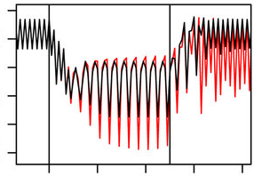
Ecosystem Stability
Background
Fishing Pressure
Resistance
Post Fishing
Resilience
Equilibrium
How ecosystems respond to disturbance
Resistance is how ecosystems respond during disturbance
Resilience is the ability for ecosystems to recover after disturbance
Fishing pressure is normally used for disturbance
Biomass
Life History Shifts
Time (Year)
No Life History Shifts
Kuparinen et al. 2016
Notes:
So we want to test ecosystem stability. Stability has two components: resistance and resilience. Resistance measures how little change an ecosystem undergoes when disturbed, while resilience measures the ability of an ecosystem to recover from disturbance. In theses studies, disturbance is usually simulated by exposing the ecosystem to fishing pressure.
So here is an example of how we apply it.
This figure shows the total biomass in the model over a bit more than a century. The first few years shows the population in its pristine state, before the fishing occurred. The first vertical line represents the onset of fishing, and the second line is when the fishing ends again. So there are three states in this model: before fishing, during fishing, and after fishing has ended. The red line shows a scenario with life history changes, while the black line shows the control, a scenario without life history changes.
The take away is that when you incorporate life history there will be an increase in fluctuations in biomass.
So we apply fishing pressure to an ecosystem that’s already at equilibrium, and measure the changes in the mean and variance of the biomass for each species in the system. For resistance, we take this measurement during a time period with fishing exploitation, and for resilience, we take the measurement after fishing has stopped and the population is allowed to reach a new equilibrium.

Slide 11
Lake Constance
Background
Both
Body size
Maturation
Whitefish
Specific ecosystem with well known parameters
Increase in variance of biomass for both fish species
Perch
Biomass
Newborn
Total
Life History Shifts
Time (Year)
No Life History Shifts
Kuparinen et al. 2016
Notes:
Model for well studied specific ecosystem
She found an increase in variance of biomass for all the species

Slide 12
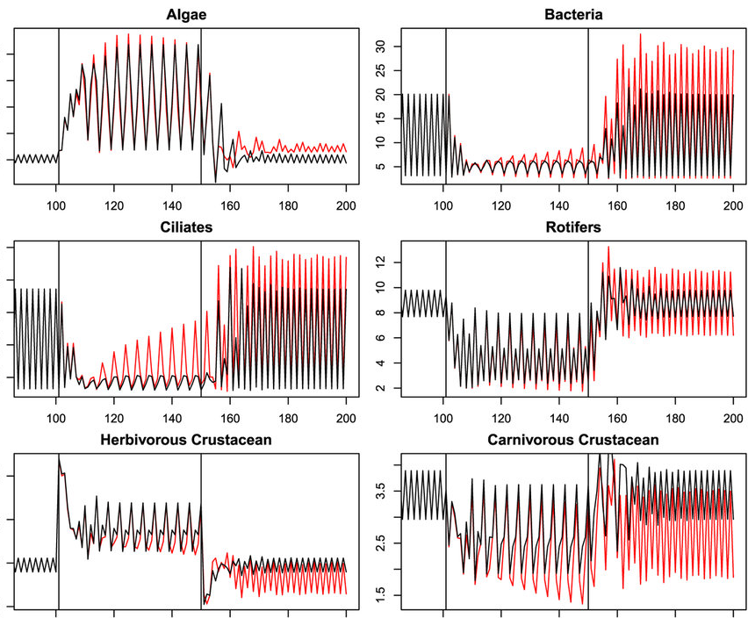
Lake Constance
Background
Algae
Bacteria
Specific ecosystem with well known parameters
Increase in variance of biomass for lower trophic levels (invertebrates)
Ciliates
Rotifers
Biomass
Herbivorous Crustaceans
Carnivorous Crustaceans
Life History Shifts
Time (Year)
No Life History Shifts
Kuparinen et al. 2016
Notes:
These fluctuations resonated through the entire ecosystem, including lower trophic levels.

Slide 13
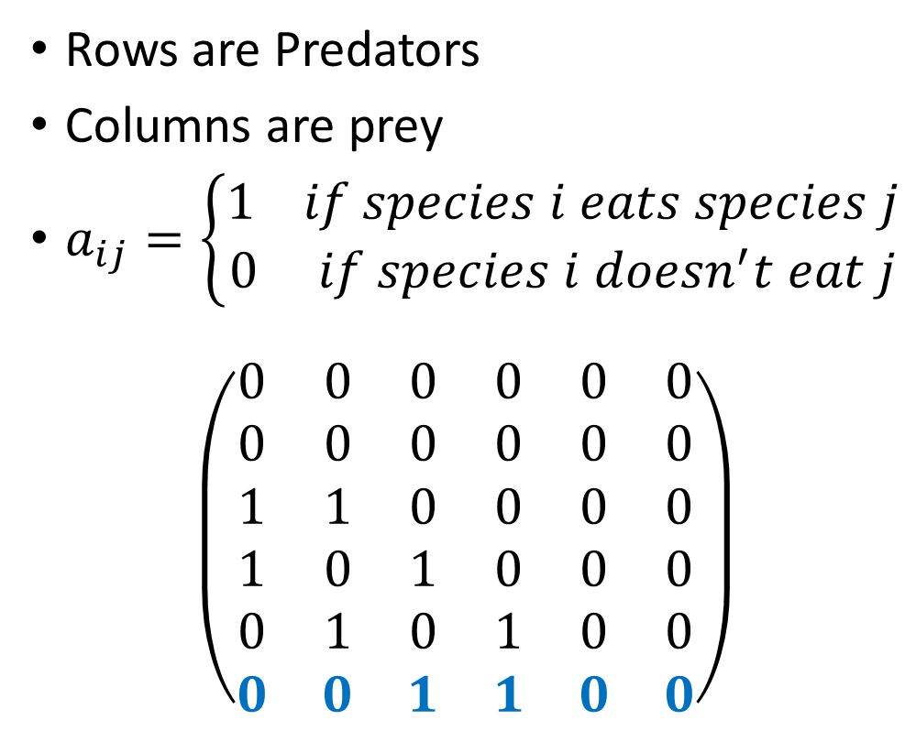
Species Matrix
Background
Rows are Predators
Columns are prey
$a_{ij}=\left\{\begin{aligned}1 if species i eats species j \\ 0 if species i doesn^{′}t eat j\end{aligned}\right.$
$$\left(\begin{matrix}0 & 0 & 0 & 0 & 0 & 0 \\ 0 & 0 & 0 & 0 & 0 & 0 \\ 1 & 1 & 0 & 0 & 0 & 0 \\ 1 & 0 & 1 & 0 & 0 & 0 \\ 0 & 1 & 0 & 1 & 0 & 0 \\ 0 & 0 & 1 & 1 & 0 & 0\end{matrix}\right)$$
6
5
4
3
Predators
1
2
Prey
Notes:
So the allometric trophic network starts by creating a random food web to show the dietary links between species. You can think of the rows as your predators and your columns as your prey. The elements in the matrix are either 1 or 0. If it’s 1 it means that predator in row i consumes prey in column j. The graph on the right shows what this food web looks like. So your first two rows in this case are your autotrophs, your algae, because you can clearly see that they don’t eat anything else. They are shown by the red circles. Row 3 eats both autotrophs, which you can also see in the graph, 3 eats 1 and 2. (continue on)
Species have been sorted by body mass, so it will always yield a lower triangular matrix.
A distinctive feature of this is that there isn’t any cannibalism present in this model, as you can see that the diagonal consists of 0s.
For the sake of this example, I defined the last row, species 6, as a fish, and colored it blue.

Slide 14
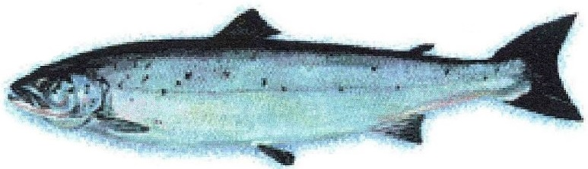
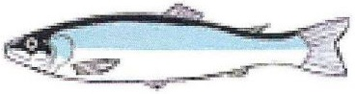
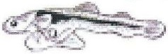
Species Matrix
Methods
8
Reproduction
Growth
5
7
4
6
3
1
2
Notes:
The nice thing about this model is that you treat new life stages as new nodes in the web, since they have different diets. You can connect the

Slide 15
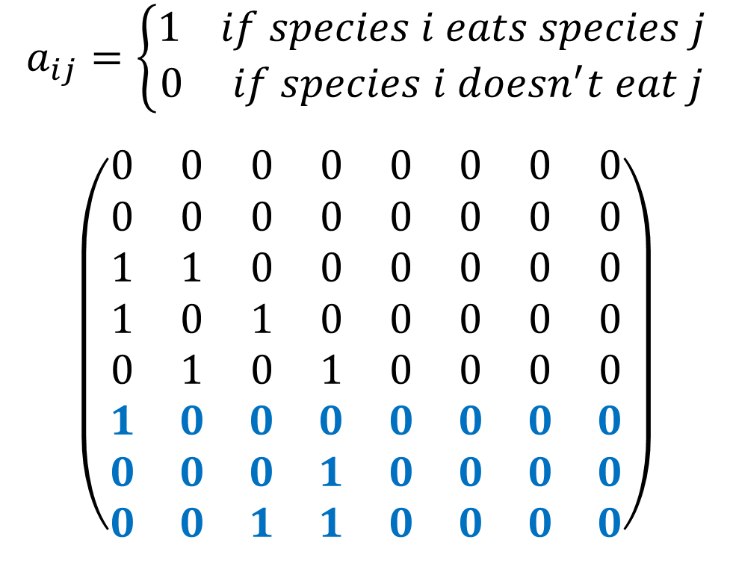
Species Matrix
Methods
$$a_{ij}=\left\{\begin{aligned}1 if species i eats species j \\ 0 if species i doesn^{′}t eat j\end{aligned}\right.$$
$$\left(\begin{matrix}0 & 0 & 0 & 0 & 0 & 0 & 0 & 0 \\ 0 & 0 & 0 & 0 & 0 & 0 & 0 & 0 \\ 1 & 1 & 0 & 0 & 0 & 0 & 0 & 0 \\ 1 & 0 & 1 & 0 & 0 & 0 & 0 & 0 \\ 0 & 1 & 0 & 1 & 0 & 0 & 0 & 0 \\ 1 & 0 & 0 & 0 & 0 & 0 & 0 & 0 \\ 0 & 0 & 0 & 1 & 0 & 0 & 0 & 0 \\ 0 & 0 & 1 & 1 & 0 & 0 & 0 & 0\end{matrix}\right)$$
8
5
7
4
Predators
6
3
1
2
CANNIBALISM
Prey
Notes:
So now when you want to add life histories to the fish species, all you need to do is add in more rows. So in this example I added two life stages to this fish species. In this graph maturation is shown by green arrows, so 6 matures to 7, and 7 matures to 8.
Take note that there is no cannibalism present in this model, as you can see that 8 does not eat 7 or 6, and 7 does not eat 6.

Slide 16
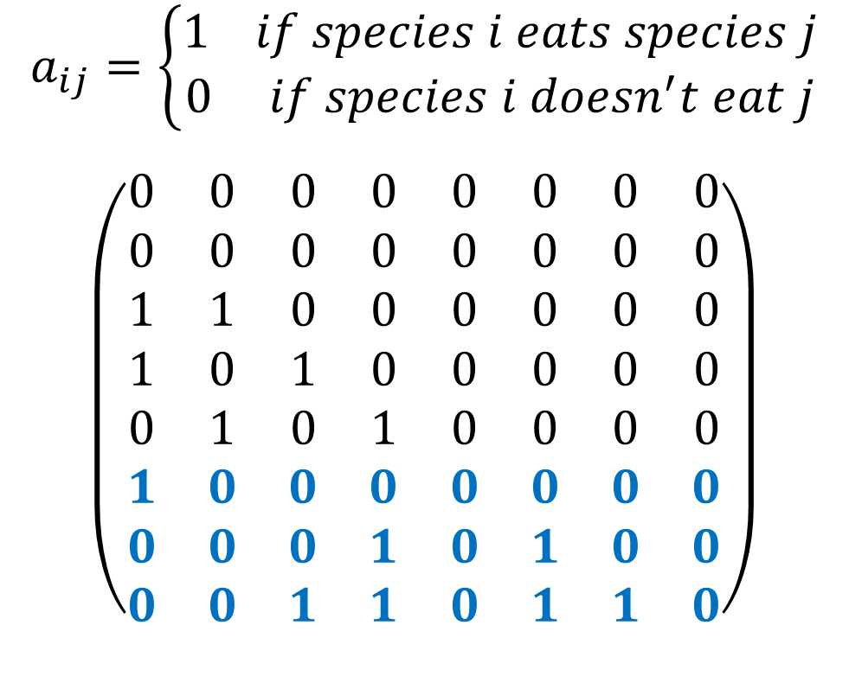
Species Matrix
Methods
$$a_{ij}=\left\{\begin{aligned}1 if species i eats species j \\ 0 if species i doesn^{′}t eat j\end{aligned}\right.$$
$$\left(\begin{matrix}0 & 0 & 0 & 0 & 0 & 0 & 0 & 0 \\ 0 & 0 & 0 & 0 & 0 & 0 & 0 & 0 \\ 1 & 1 & 0 & 0 & 0 & 0 & 0 & 0 \\ 1 & 0 & 1 & 0 & 0 & 0 & 0 & 0 \\ 0 & 1 & 0 & 1 & 0 & 0 & 0 & 0 \\ 1 & 0 & 0 & 0 & 0 & 0 & 0 & 0 \\ 0 & 0 & 0 & 1 & 0 & 1 & 0 & 0 \\ 0 & 0 & 1 & 1 & 0 & 1 & 1 & 0\end{matrix}\right)$$
8
5
7
4
Predators
6
3
1
2
Prey
CANNIBALISM
Notes:
So if you want to add cannibalism to the model, you can simply modify the lower triangle of the intraspecific interactions.

Slide 17
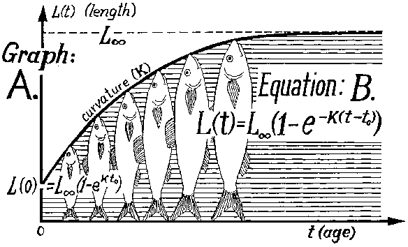
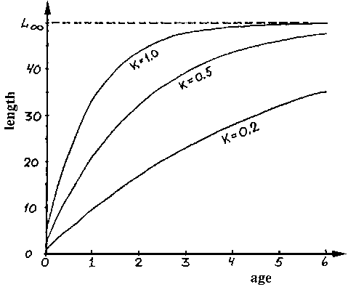

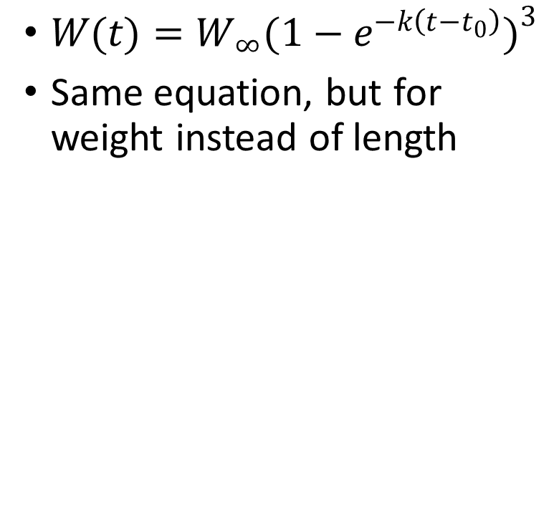
Von Bertalanffy Growth
Methods
$W(t)=W_{∞}(1−e^{−k\left(t−t_{0}\right)})^{3}$
Same equation, but for weight instead of length
Notes:
In order to give a realistic diet for the new life stages that we create, we need to estimate the size of the new life stages, since fish are limited to eating prey smaller than themselves. Since the model gives us adult weights for fish species, we can work backwards to deduce the weight at each life stage using the von Bertalanffy growth curve.
So this equation tells us how long the fish will be at any point in time. So the length at time t is equal to the asymptotic length, or the theoretical length that a fish would reach if it continued to grow for eternity, times the

Slide 18
Aims & Contributions to the Field
Conclusion
Hope to generalize Lake Constance results
Fishing increases fluctuations in biomass
Life history shifts amplify these fluctuations
Entire ecosystem is destabilized, including invertebrates and autotrophs
Cannibalism
Cannibalism should reduce the food available to other species
Increased autocorrelation for cannibalistic species
Notes:
So Anna Kuparinen found some very exciting results with life history shifts in a model simulating lake Constance.

Slide 19
Timeline
Timeline
Dates | Goal
April-May, 2016 | Parameter estimation
June-July, 2016 | Code development (Modify ATN model)
August-December, 2016 | Model simulations Sensitivity analyses
January-April, 2017 | Thesis writing
May 2017 | Thesis submission and defence

Slide 20
Does a convergence of body size increase recovery through an increase in competition?
Notes:
Does a convergence of body size increase recovery through an increase in competition?

Slide 21
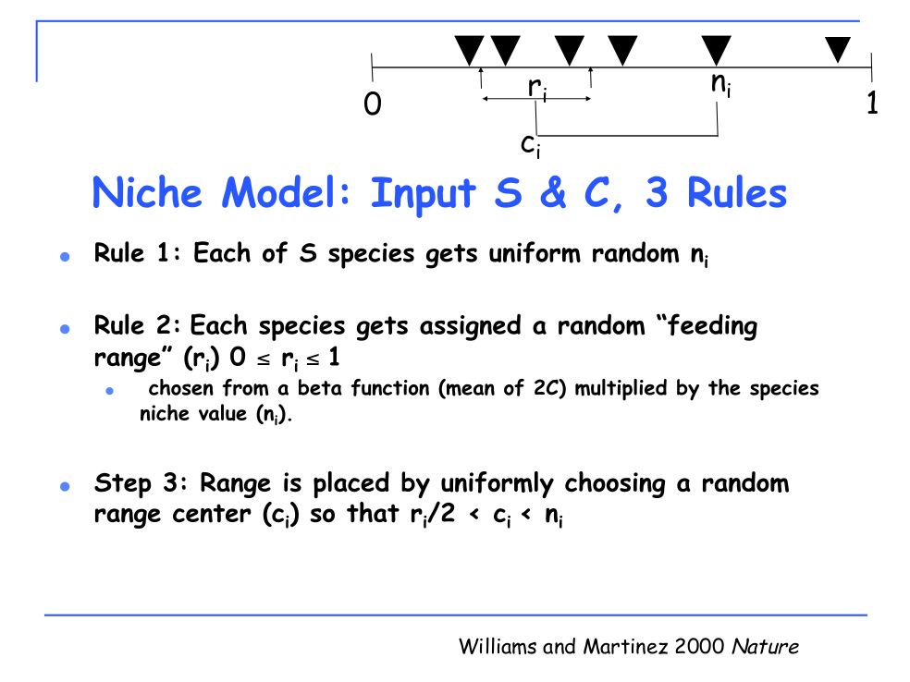
Slide created by Neo Martinez

Slide 22
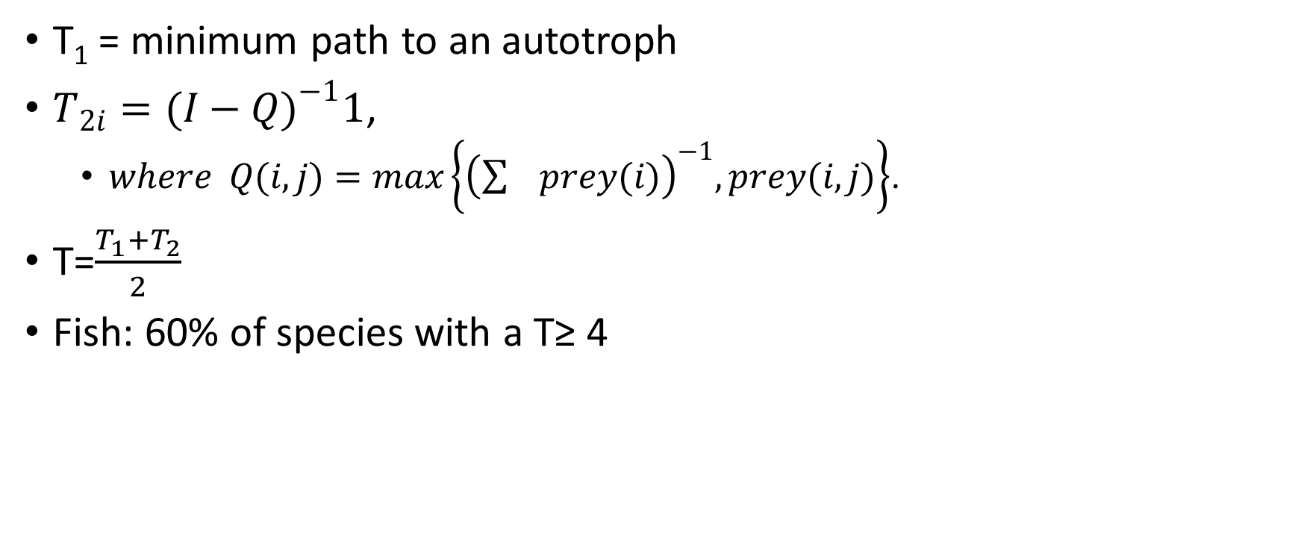
Trophic Levels (T)
Background
6
T₁ = minimum path to an autotroph
$T_{2i}=(I−Q)^{−1}1$,
$where Q(i,j)=max\left\{{\left(\sum{prey(i)}\right)}^{−1}, prey(i,j)\right\}$.
T=$\frac{T_{1}+T_{2}}{2}$
Fish: 60% of species with a T≥ 4
5
4
3
1
2
Notes:
60% of species with a trophic level greater or equal to 4 are defined to be fish

Slide 23
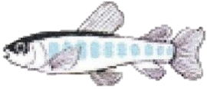
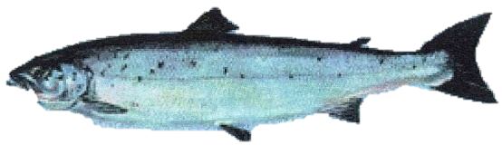
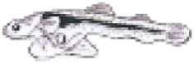
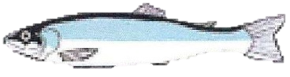
Background
Reproduction
Growth

Slide 24
Runge-Kutta Conceptual Model Parameters from Hutchings et al.
Background
R₄
R₃
R₂
F₁
F₂
F₃
F₄
R₁
P₁
P₂
P₃
Nutrients
Phytoplankton
Zooplankton
Notes:
So now that we know how to model life history structure, we can add it to the general closed NPZ model. I used the Runge-Kutta method to solve the model. To keep things simple, I limited it to four life stages, with the first two only eating phytoplankton, and the last two only eating zooplankton. I took parameters from Hutchings.

Slide 25
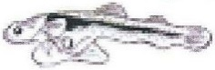
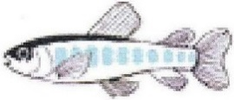

Background
Subscript=Life Stage
F=Fish Biomass
P=Probability of surviving to next stage
R=Reproduction
m=mass per individual
R₄
R₃
R₂
F₁
m₁
F₂
m₂
F₃
m₃
F₄
m₄
R₁
P₁
P₂
P₃
Notes:
You can summarize the life history rates with this conceptual model. The subscript represents life stage, so this model shows four life stages. F(i) is the fish biomass at each life stage, R(i) is the reproductive rate of each life stage, and P(i) is the probability of maturing from stage i to stage i+1

Slide 26
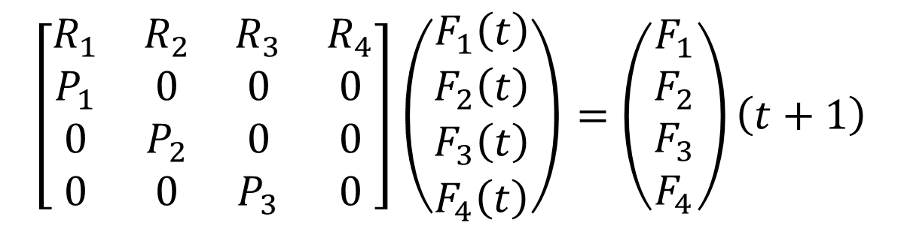
Leslie Matrix
Background
R₄
R₃
R₂
F₁
F₂
F₃
F₄
R₁
P₁
P₂
P₃
$$\left[\begin{matrix}R_{1} & R_{2} & R_{3} & R_{4} \\ P_{1} & 0 & 0 & 0 \\ 0 & P_{2} & 0 & 0 \\ 0 & 0 & P_{3} & 0\end{matrix}\right]\left(\begin{matrix}F_{1}\left(t\right) \\ F_{2}\left(t\right) \\ F_{3}\left(t\right) \\ F_{4}\left(t\right)\end{matrix}\right)=\left(\begin{matrix}F_{1} \\ F_{2} \\ F_{3} \\ F_{4}\end{matrix}\right)\left(t+1\right)$$
Patrick Leslie
Rockwood 2009
Notes:
This can be summarized into a Leslie life history matrix, which were invented by Patrick Leslie, where entry a(ij) is the contribution of biomass from the j^{th} column to the i^{th} row.

